Slide 1
A Bad Time or a Bad Business?
Identification of Profitable Firms with Short Run Problems
Diego Escobar
Juan Ignacio Vila
June 2019

Slide 2
Outline
Problem
Assumptions and filtering over the data
Data sources and descriptive statistics
Models
Results
Discussion and findings
Caveats

Slide 3
Problem: Description of the issue
Small firms have short-term constraints that may lead them to closure.
Even if we counted with policy instruments that could help firms survive in the short run, it is not clear that we should support all of them:
Some would be profitable in the long if they survive those “bad times”.
Some others are simply not profitable. If we wanted to assist them we should point them somewhere else.
Policy goal: Improve businesses profitability, employment creation and general improvement of the neighborhoods where the firms operate.

Slide 4
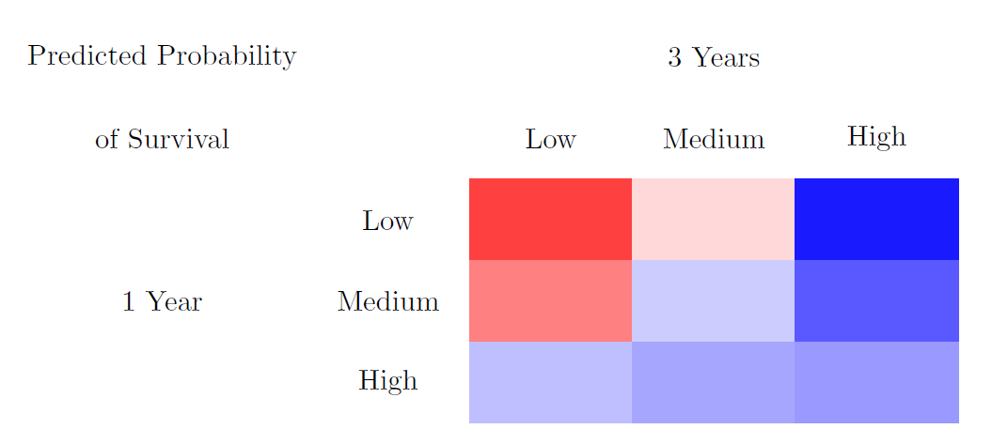
Problem: Survival as Proxy for Profitability

Slide 5
Assumptions and filtering over the data to predict
We decided to focus in the firms that were created in each time frame (i.e. omitting already existing firms).
We run the model from the years 2006 to 2015 (in training data, which is the last year that we can introduce in the model.
The overall sample has 900,000 licenses and around 200,000 unique businesses. Filtering for newly issued licenses reduces the sample to 150,000 thousand observations.

Slide 6
Data sources and descriptive statistics
Data | Description | Time available
Business Licenses | Data base with characteristics of the licenses | 1998-2019
Chicago crime data | Data base with the reported crime data | 2001-2019
Transit data | Transit data of Chicago | 2006-2019
Chicago Bounderies | Chicago boundaries for geo merging | N/A
One issue to take into consideration is the time span where we run the models. We decide to use from 2006 to 2015, so ACS data is not available. Nevertheless, many of the variables used characterize the sample geographically and are highly correlated with socioeconomical data from ACS.

Slide 7
Data sources and descriptive statistics: Duration of the firms

Slide 8
Models
We select the best hyper-parameters configuration for every time window and outcome. For the time being we only use Logistic Regression (LR) and Random Forest (RF).
We run a total of 27 (9 LR and 18 RF) models for 4 outcomes, over a span of 10 years.
We run the models run with a total of 1121 features.

Slide 9
Results: Outcomes – One year Precision-Recall

Slide 10
Results: Outcome - Three year Precision-Recall

Slide 11
Results at different threshold

Slide 12
Results: Over time at k=20%
*Model used in this part is RF.
Notes:
On May 9, 2012, the Chicago City Council approved Mayor Rahm Emanuel’s reform ordinance which reduces the number of business licenses by 60% and will lower licensing fees for over 10,000 businesses in Chicago. The effort will also cut red tape, improve transparency, and offer consolidated licenses for commonly paired activities. It will make it easier to start and grow a business in Chicago. For one year model, this effect are softened in the three year model
2008 crisis.

Slide 13
Discussion and Findings
Work in progress: Crossing of the predicted labels.
We observe an issue with outcomes between 1 and 2 years. Nonetheless, the models precision remains over the baseline.
We can see that the models may be capturing structural changes that occured during the sample period (2008 crisis and 2012 business licenses reform).

Slide 14
Caveats
Survival data as a proxy for our policy goal: business survival does not necessarily translate into businesses profitability, employment creation or in general positive spillovers over the neighborhoods where they operate.
Structural changes.
We identify a subset of firms that should be inspected more closely and that are likely to close. We do not assert whether they would benefit from a particular program.
Data availability:
Over a long time horizon: potentially up to 5 years ahead.
Lack of firm financial data.

